Slide 1

Overpowered
Walktime Error
Cynthia Khan, Ricky Le, Caio Melo, Sean Silva, Noah Yasarturk

Slide 2

Problem Stage

Slide 3

What is Overpowered?
PROBLEM
Universities and businesses the like needlessly waste money on unmonitored and unregulated energy consumption and leaves the student/consumer often footing the bill. In the 21st century there should be a system in which automatically cuts that energy consumption and therefore cuts the cost.
SOLUTION
Overpowered is an intelligent system by which business clients can reduce their utility bill through provided data analytics and integrated hardware systems.

Slide 4
The Competition
Verdigris Smart Building Management- Cloud Based; insecure; no SmartBulb integration
Noveda EnergyFlow Monitor - no SmartBulb integration
WattVision - no SmartBulb integration
Curb Energy - for a home, not for a large scale set of buildings

Slide 5
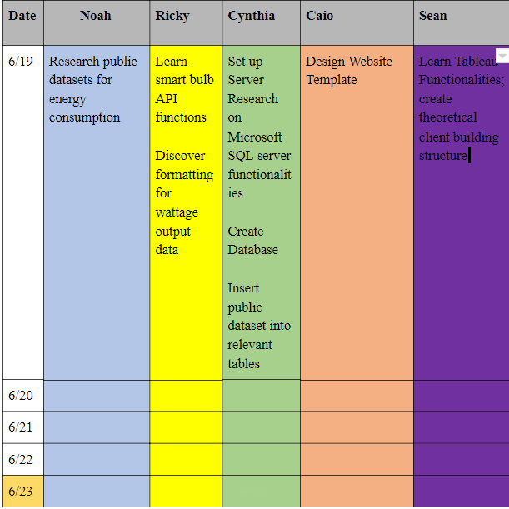
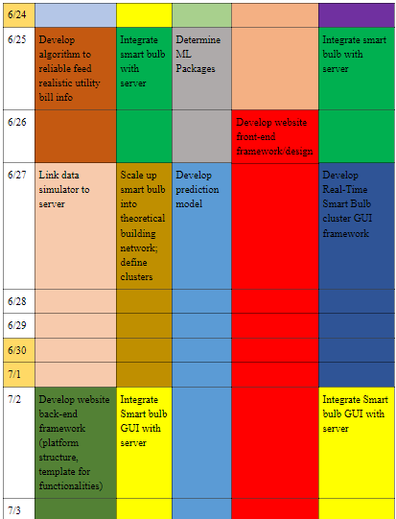
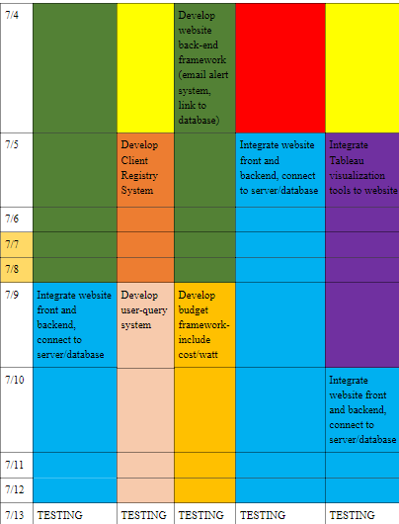
Our Planning, Not According to Plan
Originally, we tried the incremental mode. The assignments forced us into the waterfall model.
We ended up using SmartSheets- Gantt chart software.

Slide 6
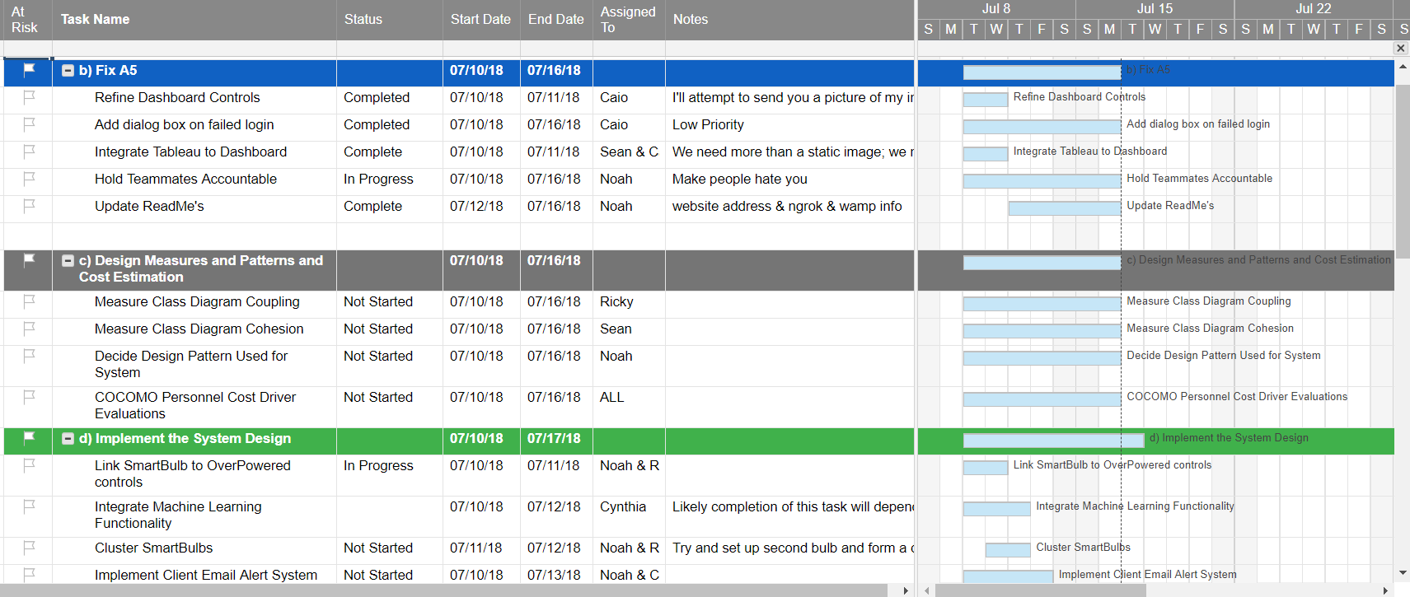
Planning

Slide 7
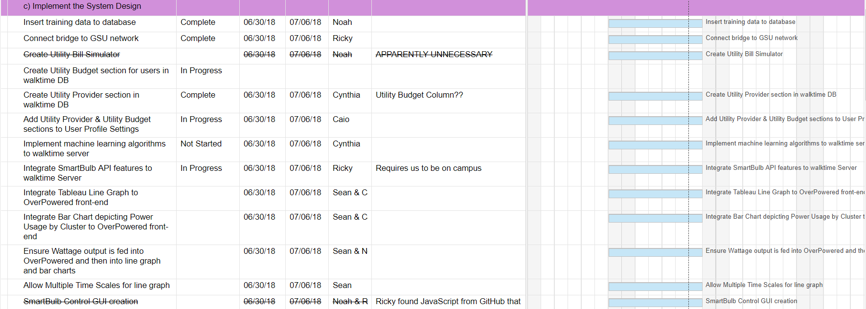
Collaboration
Planning and Scheduling: http://bit.ly/2L3bcfB
GitHub: https://github.com/overpowered-gsu
Slack: https://walktime-error.slack.com/
YouTube: http://bit.ly/2urBXjp

Slide 8
Requirement Stage

Slide 9
Requirement 1 Obtain Utility Bill Data and Implement into Database
Requirement 2 Create/Configure Server to be Database
Requirement 3 Develop Client Registry Parameters and Definition
Requirement 4 User Credential Setup and Execution
Requirement 5 Recover Lost Password
Requirement 6 Website Aesthetics / Dashboard
Requirement 7 Implement Machine Learning Algorithms
Requirement 8 Configure/Integrate Smart Bulb API Features
Requirement 9 Integrate Tableau Data Visualization with Dashboard

Slide 10
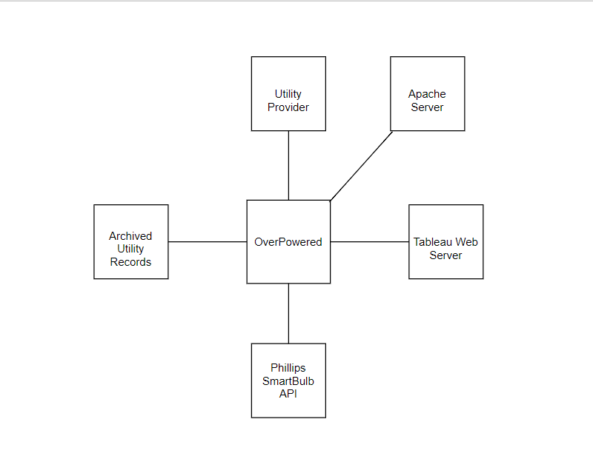
Context Model

Slide 11
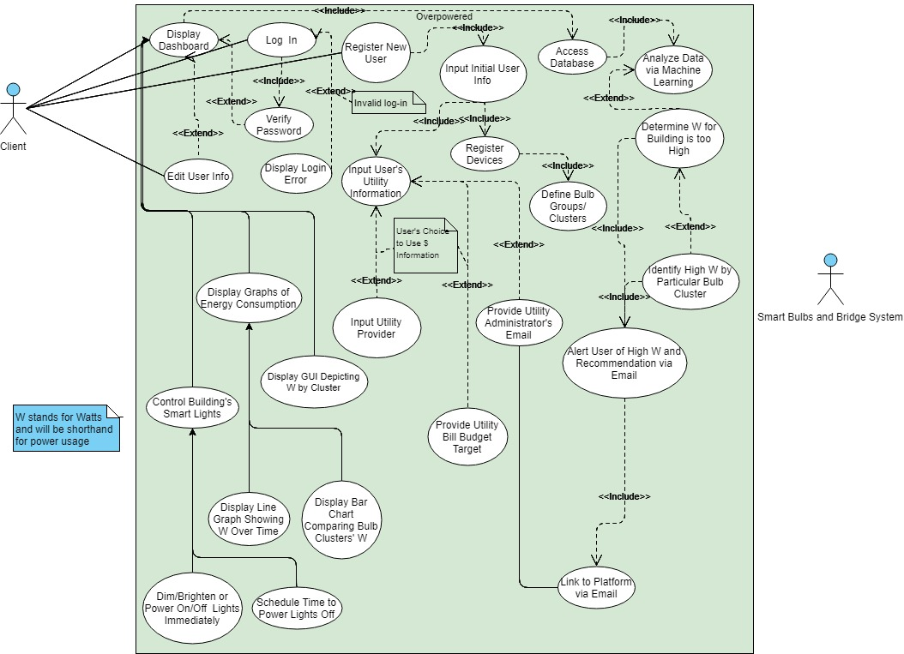
Use Cases
Register New User
Authenticate and Direct User Login
Display Dashboard
Integrate Database Functionalities
Integrate SmartBulb API Functionalities
Implement Machine Learning Model

Slide 12
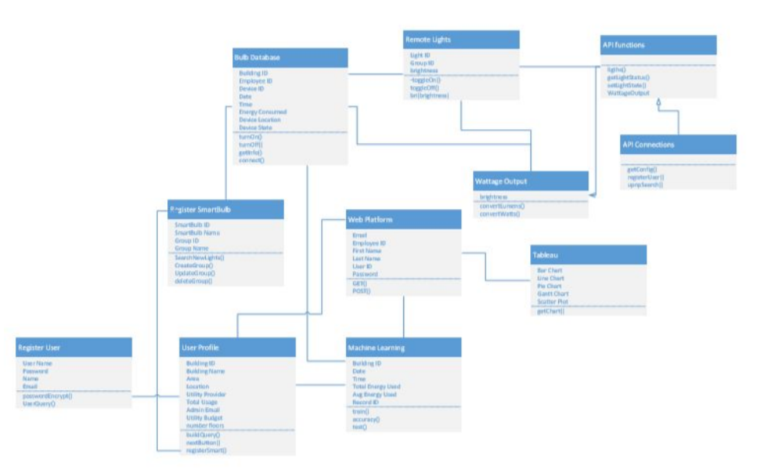
Class Diagram

Slide 13
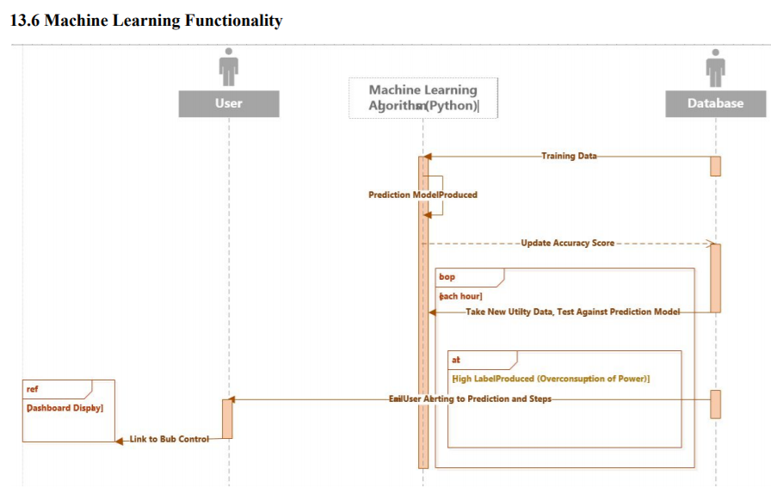
Sequence Diagram

Slide 14
Design Stage

Slide 15
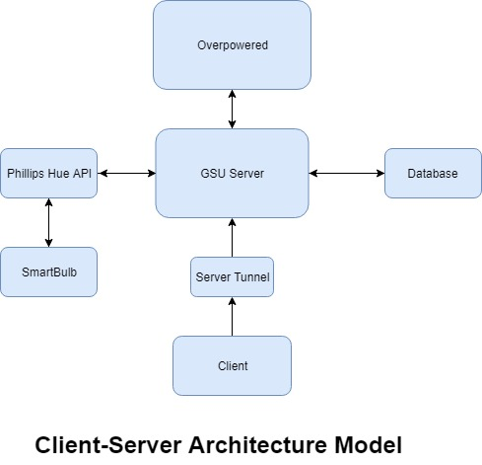
Client-Server Architecture

Slide 16
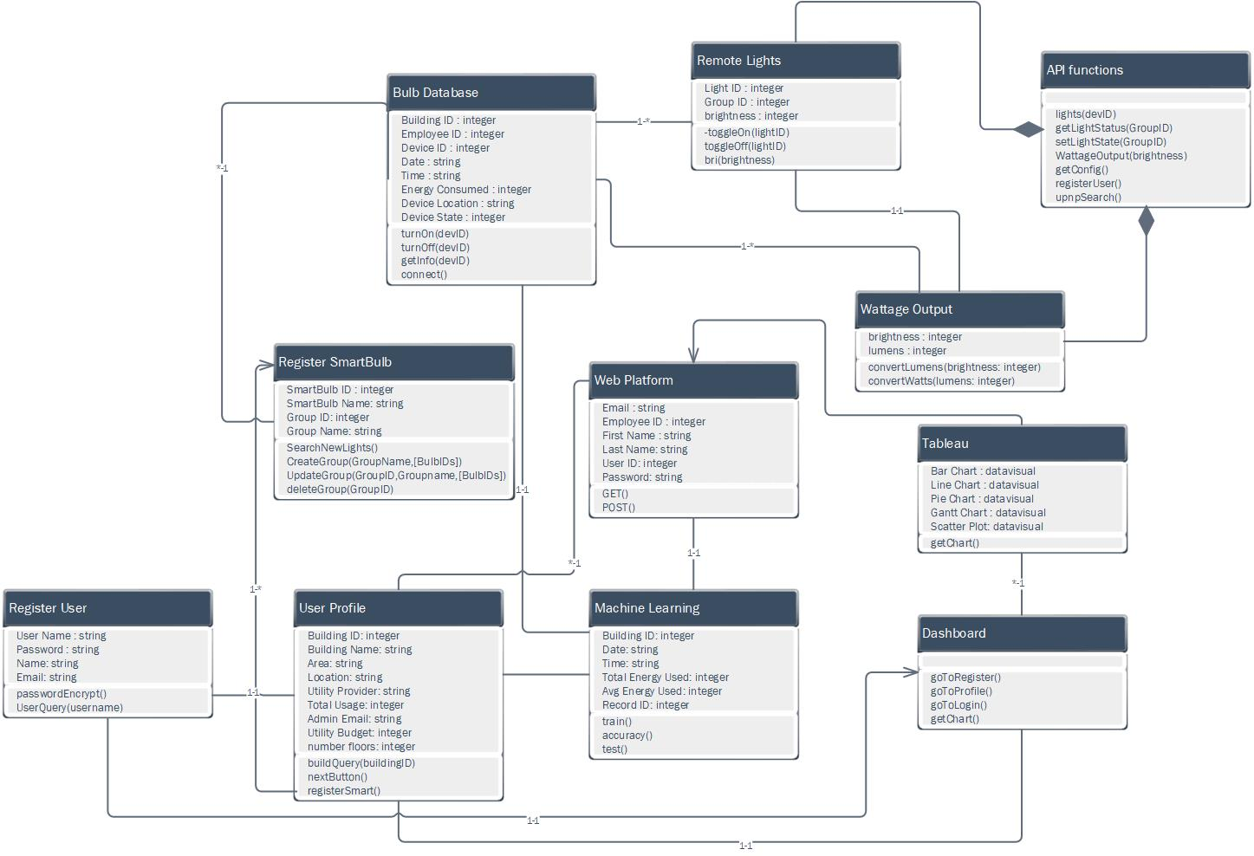
Revised Class Diagram

Slide 17
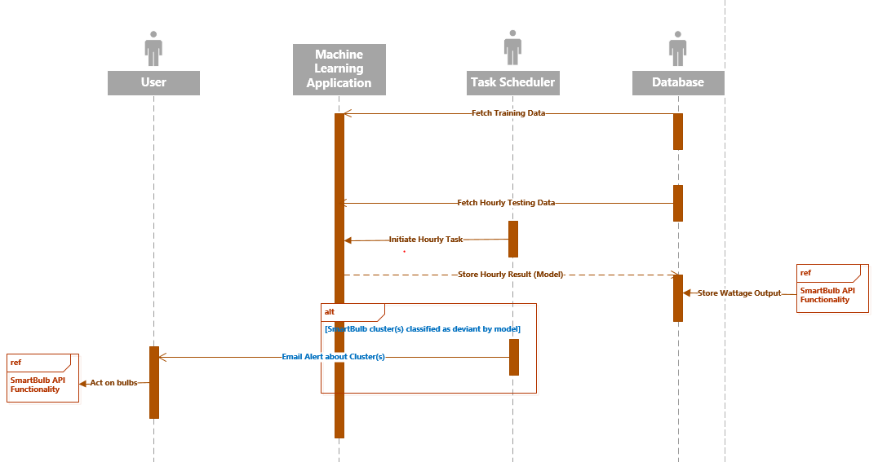
Revised Sequence Diagram

Slide 18
Implementation

Slide 19





Implementation
Website- HTML, CSS, JavaScript via Bootstrap Studio, ngrok tunnel
GSU Server - mySQL Server,WAMP, mySQL Workbench, PHP to link HTML
Machine Learning- Python, Scala
Philips Hue API - HTML, JavaScript, NodeJS, Browserify, RESTful
Tableau API - HTML, JavaScript
Editors - Sublime Text, Notepad++

Slide 20
Database Specifications
MySQL Workbench to manipulate SQL tables
2 tables: tableau and employee
Tableau has columns:
Utility Provider, Statement Date, Total Bill Amount, Site Name
Employee has columns:
Register Date, Employee ID, First Name, Last Name, Email, (encrypted) Password

Slide 21
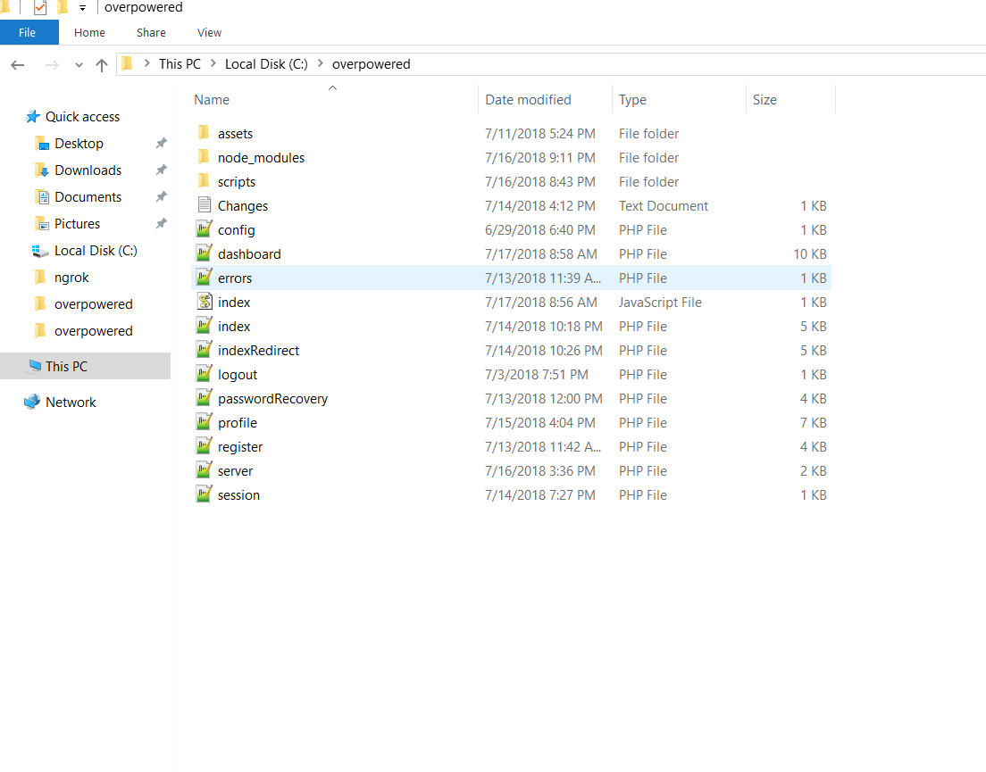
Structure

Slide 22
Testing Stage

Slide 23
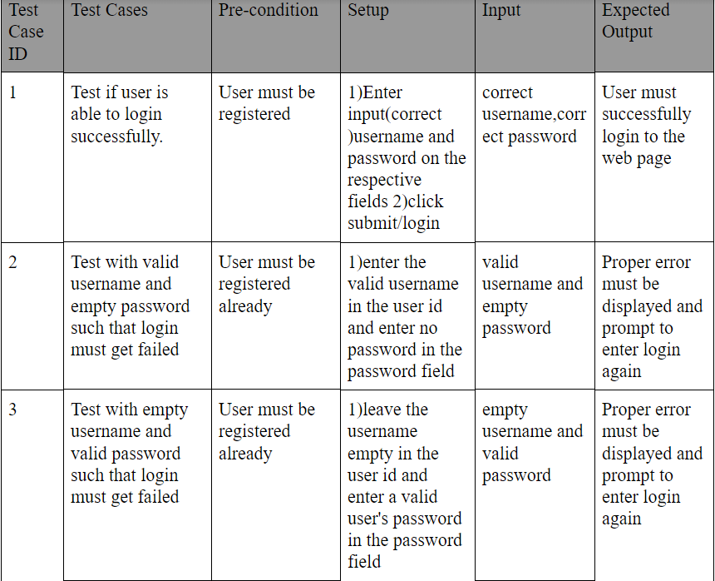
Testing

Slide 24
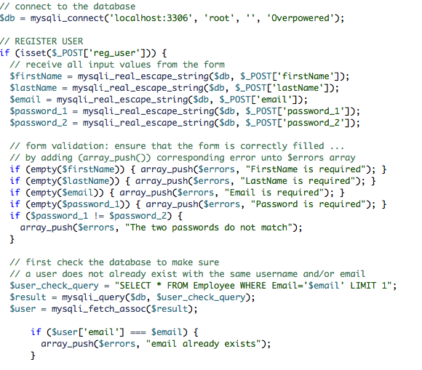
Demo(Example)
Use Case (1) - Register Profile
Use Case (2) - Log In
walktime.ngrok.io

